Slide 1

Customer Shopping Behavior Analysis
Analysis of 3,900 transactions to uncover spending patterns, customer segments, product preferences, and subscription behavior to guide strategic decisions.

Slide 2

Dataset Summary
Scope
Key Features
Behavioral Fields
3,900 rows × 18 columns covering demographics, purchases, and behavior.
Age, Gender, Location, Subscription, Item, Category, Amount, Season, Size, Color.
Discount applied, promo code used, previous purchases, frequency, rating, shipping.
Data Quality
37 missing values in Review Rating column.

Slide 3

Data Preparation & Feature Engineering
Loaded data with pandas, inspected structure (df.info()) and summary stats (.describe()).
Imputed Review Rating missing values using category median.
Renamed columns to snake_case for consistency.
Engineered age_group and purchase_frequency_days.
Dropped redundant promo_code_used after consistency check with discount_applied.

Slide 4

Database Integration
Connected cleaned DataFrame to PostgreSQL and loaded data for structured SQL analysis to support business queries and dashboarding.

Slide 5
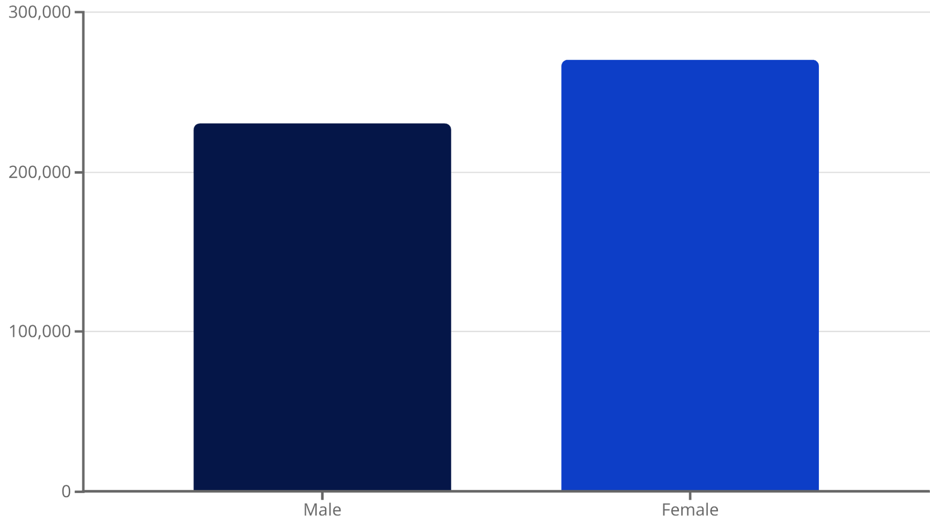
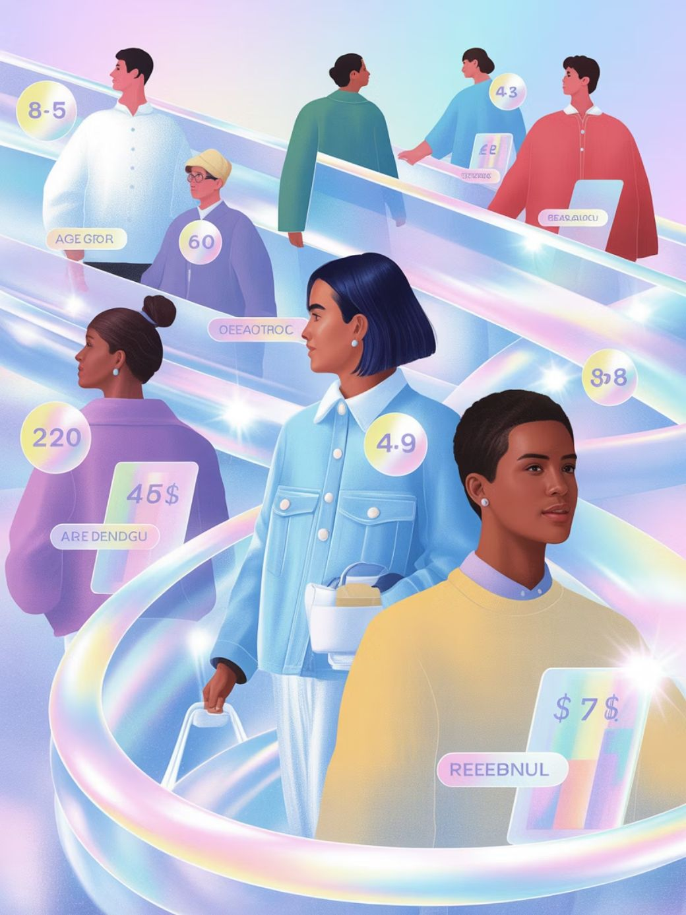
Revenue & Demographics
Compared total revenue by gender and calculated revenue contribution by age group to identify high-value demographics for targeting.

Slide 6


High-Value Discount Users & Discount-Dependent Products
Identified customers who used discounts yet spent above average. Also flagged top 5 products with highest percentage of discounted purchases to review pricing strategy.
Top Rated Products
Blouse
Dress
Shirt

Slide 7

Product Performance & Ratings
Top 5 by Rating
Top 3 per Category
Listed highest average review products to prioritize in campaigns and inventory.
Most purchased items within each category identified for merchandising focus.

Slide 8
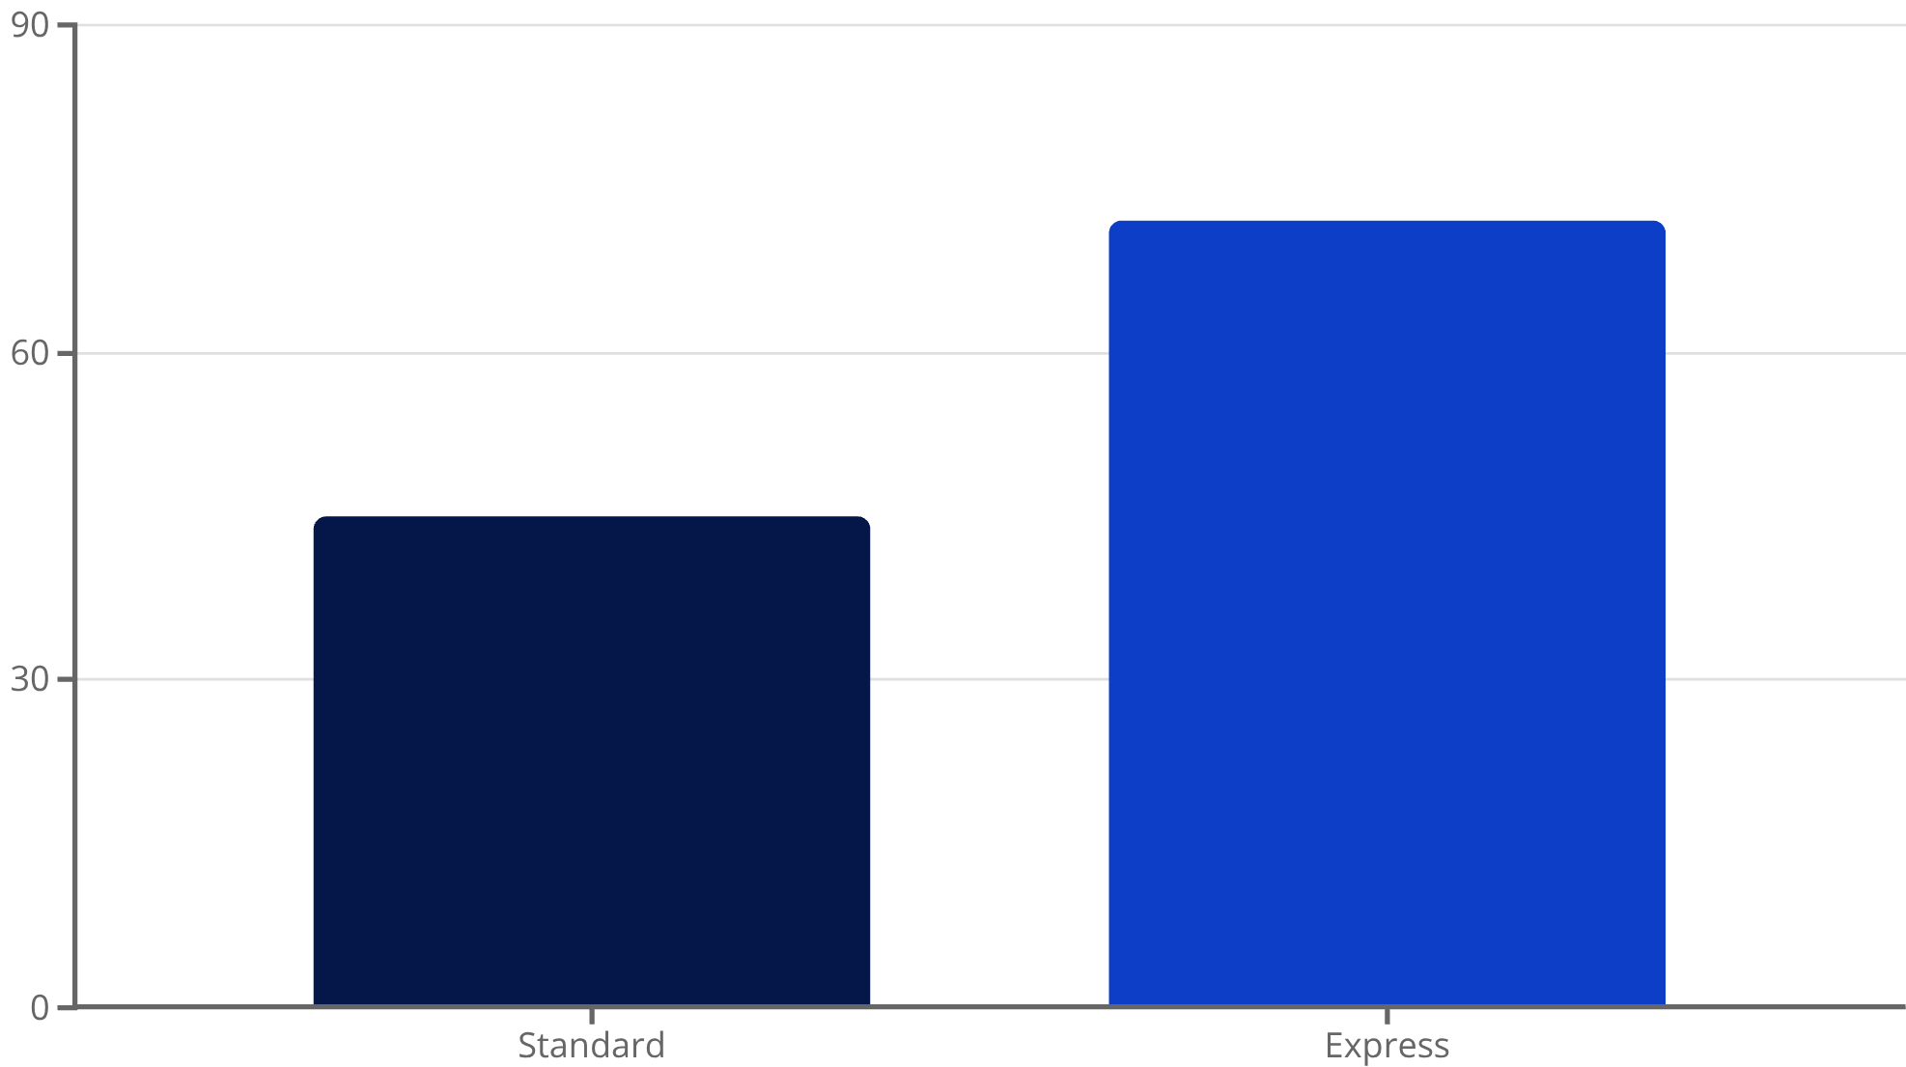
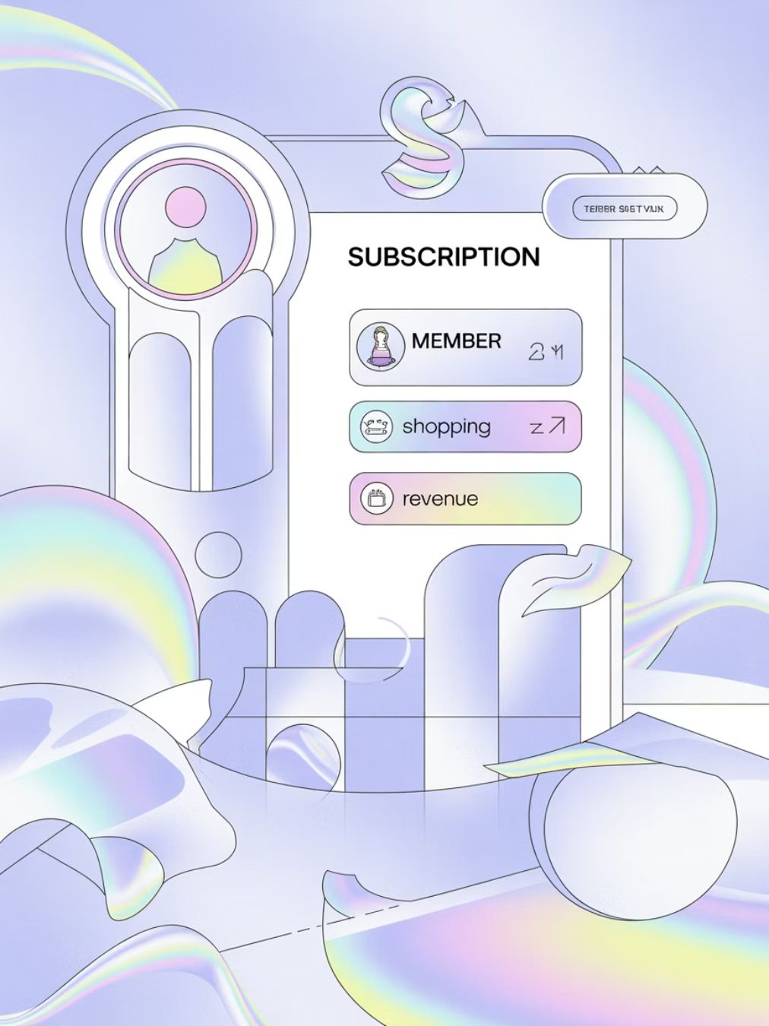
Shipping & Subscription Insights
Compared average purchase amounts between Standard and Express shipping. Also compared subscribers vs. non-subscribers on average spend and total revenue to quantify subscription value.

Slide 9
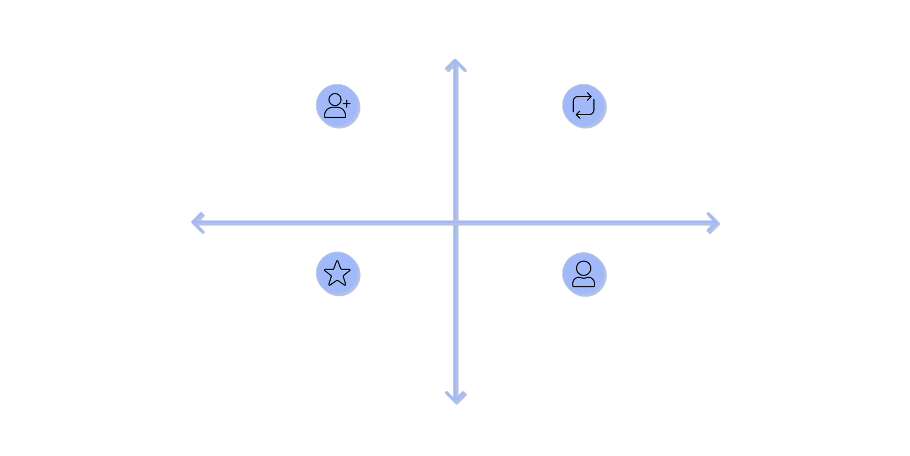

Customer Segmentation & Repeat Behavior
High Subscription Likelihood
Returning: 2–5 purchases, moderate spend, rising subscription
New: 1 purchase, low spend, low subscription
Low Average Spend
High Average Spend
Loyal: >5 purchases, high spend, high subscription
At-risk: prior buyers with declining spend
Low Subscription Likelihood
Segmented customers into New, Returning, and Loyal; analyzed whether >5 purchases correlates with higher subscription rates and greater lifetime value.

Slide 10
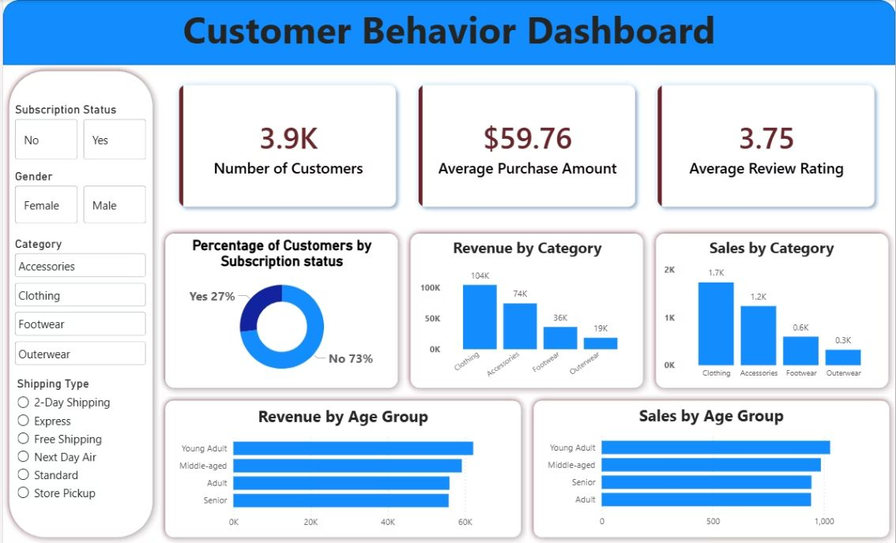
Business Recommendations & Dashboard
1
2
3
Boost Subscriptions
Customer Loyalty Programs
Review Discount Policy
Promote exclusive benefits to increase subscriber conversion and revenue.
Reward repeat buyers to move them into the Loyal segment.
Balance sales uplift with margin control for discount-dependent products.
4
Interactive Power BI dashboard built to present insights and support ongoing analysis.
Product Positioning & Targeting
Promote top-rated and best-selling products; focus marketing on high-revenue age groups and express-shipping users.

